Slide 1


Presented- Dr.Ajaysingh Chauhan
WAVECON
TELECOM
ANALYSIS

Slide 2
Overview:
Wave con , a leading telecom provider in India, launched its 5G plans in May 2022, along with other telecom providers. After the 5G launch, Wave con noticed a decline in active users and revenue growth. The company has tasked its analytics team with creating a comparison report of key performance indicators (KPIs) between the pre and post-launch phases of 5G

Slide 3
Objectives Ad-Hoc Questions :
1 . IMPACT OF 5G ON REVENUE
What is the impact of the 5G launch on our revenue ?
2 . UNDERPERFORMING KEY PERFORMANCE INDICATORS
Which KPI is underperforming after the 5G launch ?
3 . REVENUE PERFORMANCE OF MOBILE PLANS
After the 5G launch, which plans are performing well in terms of revenue ?
Which plans are not performing well ?
4 . PLANS LARGELY AFFECTED AFTER THE LAUNCH OF 5G
Is there any plan affected largely by the 5G launch ? Should it be continued or discontinued ?
5 . DISCONTINUED PLANS AFTER LAUNCH OF 5G
Is there any plan that is discontinued after the 5G launch ? What is the reason for it ?

Slide 4
Key Metrics :
ARPU (Average Revenue Per User)
ARPU goes beyond basic revenue data by providing insight into the value that each user delivers to a service. It also shows user spending trends and the ability to maximize revenue generating.
TAU ( Total Active Users)
TAU is the number of people who are actively using a telecom service. It is also an important indicator of client responsiveness to service offerings.
TSuS (Total Unsubsribed Users)
The number of users who have chosen to unsubscribe from a service is highlighted by TSuS . A lower TUsU suggests high user retention and happiness, which reflects well on service quality.
MA (Monthly Average)
The average monthly revenue generated by a telecom service provider from a single subscriber.
REVENUE
Revenue gives financial performance, allowing you to track trends and spot changes in earnings.

Slide 5
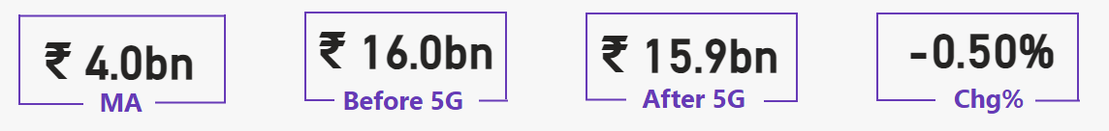
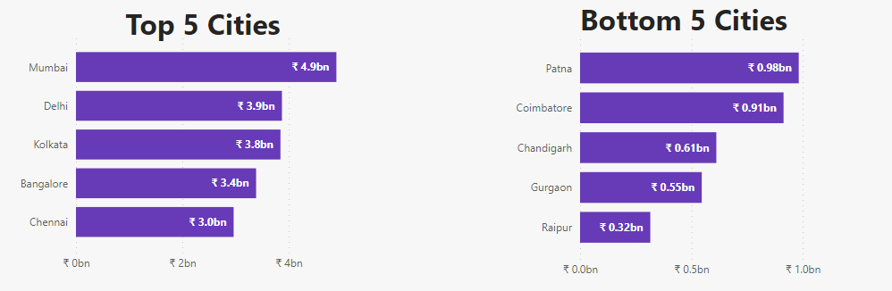
IMPACT OF 5G ON REVENUE :
A 0.5% change or 0.08 Billion of revenue drop following the launch of 5G
Mumbai and Kolkata are the best-performing cities , while Gurgaon and Raipur are the worst-performing cities

Slide 6
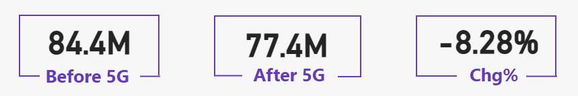
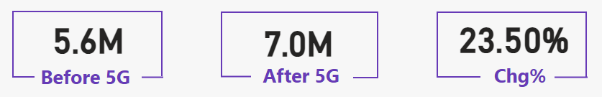
UNDERPERFORMING KPI AFTER LAUNCH OF 5G :
TAU ( TOTAL ACTIVE USERS) - DECREASED
The overall number of active users has decreased by 7 million or
-8.28%.
TUSU ( TOTAL UNSUBSCRIBED USERS) - INCREASED
Additionally, there are now more unsubscribed users than before.
The number of unsubscribers has increased by 1.4 million, or
23.50%

Slide 7
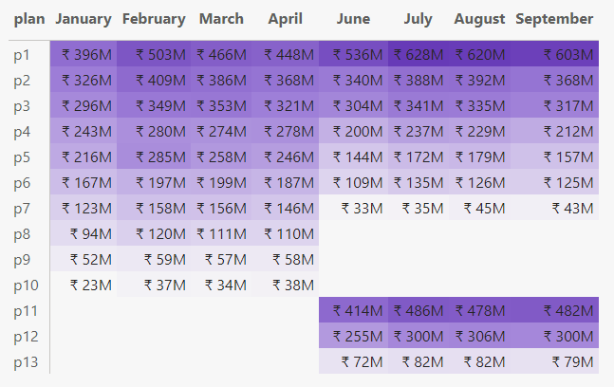
REVENUE PERFORMANCE OF MOBILE PLANS :
Before 5G Launch
After 5G Launch
- P1, P2, and P3 are the best 5G plans for
drawing in customers. The revenue for the P5,
P6, and P7 plans has significantly decreased
since the introduction of 5G services, and
they should be examined and modified.
- The P7 plan has seen a significant drop in
revenue and is the lowest-performing plan out
of all the current plans.
- P8, P9, and P10 plan was discontinued after considering their performance
- Specific 5G plans, such as P11, P12, and P13,
Was launched in June 2022 and they produced
consistent revenue

Slide 8
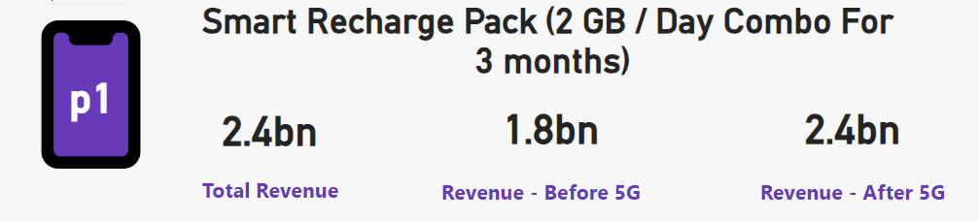
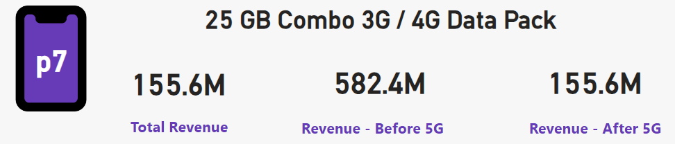
PLANS LARGELY AFFECTED AFTER THE LAUNCH OF 5G :
PLAN P1 REVENUE IMPROVED DRASTICALLY
- With a rise of 628 millions in the month of September , plan P1 is the most successful
Following the introduction of 5G.
PLAN P7 REVENUE HAS DROPPED SUBSTANTIALLY
- Plan P7 has been significantly influenced by the introduction of
5G; the income change is around 426. 8 million.
- Since this plan generates minimal revenue, it would be wise to
discontinue it and focus on other plans that can help increase
overall revenue

Slide 9
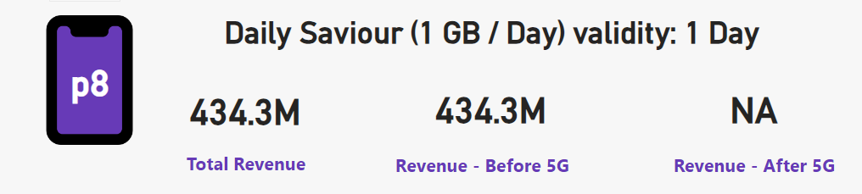
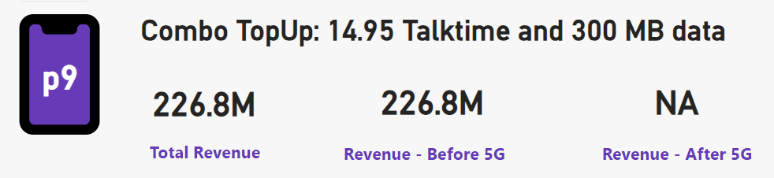
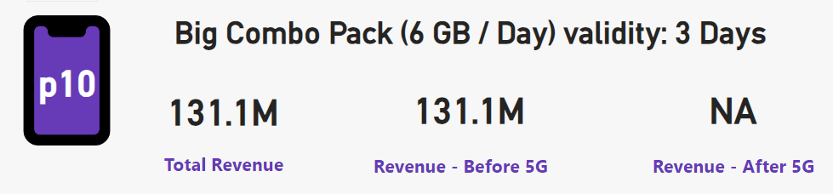

DISCONTINUED PLANS AFTER THE LAUNCH OF 5G :
- With the introduction of 5G, the Monthly Revenue of p8, p9, and p10 plans subsequently Decreased
- These plans were discontinued due to being the least profitable during the January to April period.
-The removal of these plans created space for the introduction
of new ones , aiming to increase Revenue and future Growth.
-Subsequently, successful plans P11, P12, and P13 were
introduced.
-These new plans not only compensate losses from the discontinued
ones but also contributed positively to earnings.

Slide 10
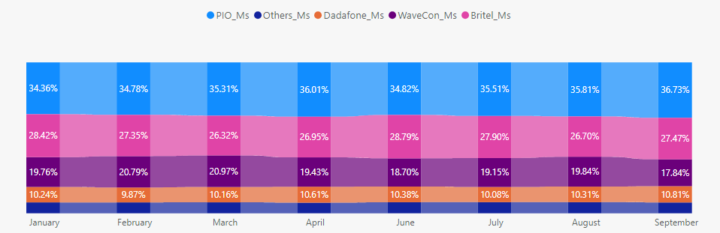
MARKET SHARE :
- in terms of market share pio stood first amongst all
- Wavecon secures the third spot in terms of market share
- Wavecon maintained an average market share of 20 % before 5G launch
- After the 5G launch the market share wavecon Average Monthly Share Decreased to 18%

Slide 11
USEFULL FEEDBACK FOR BUSINESS GROWTH :
3g/4g plans like P7 which are not Aligned with the 5G technology should be Discontinued
Seasonal promotions and other marketing ways can be used to increase Monthly Average Revenue
Analysis of 5G Impact in different cities is important to study the varying effects on connectivity and potential Business opportunities
Stay informed on competitors offerings and market trends to ensure plans remain competitive
Gathering customer feedback to better understanding customer needs , enhance service offerings and stay ahead in the competitive landscape
To improve market share , innovate product offerings , Laverage digital marketing for broader reach and invest in innovative marketing strategies

Slide 12
Thank you

